Slide 1

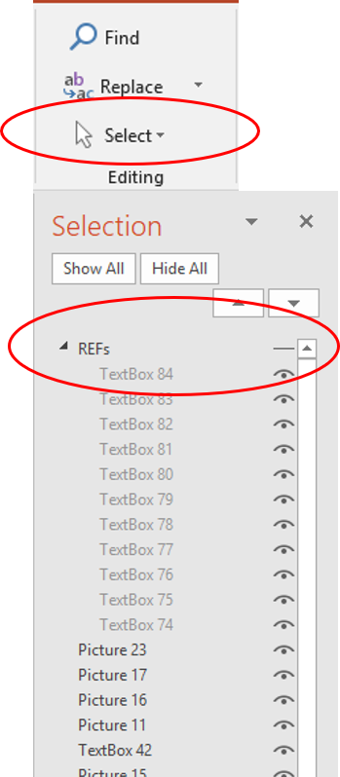

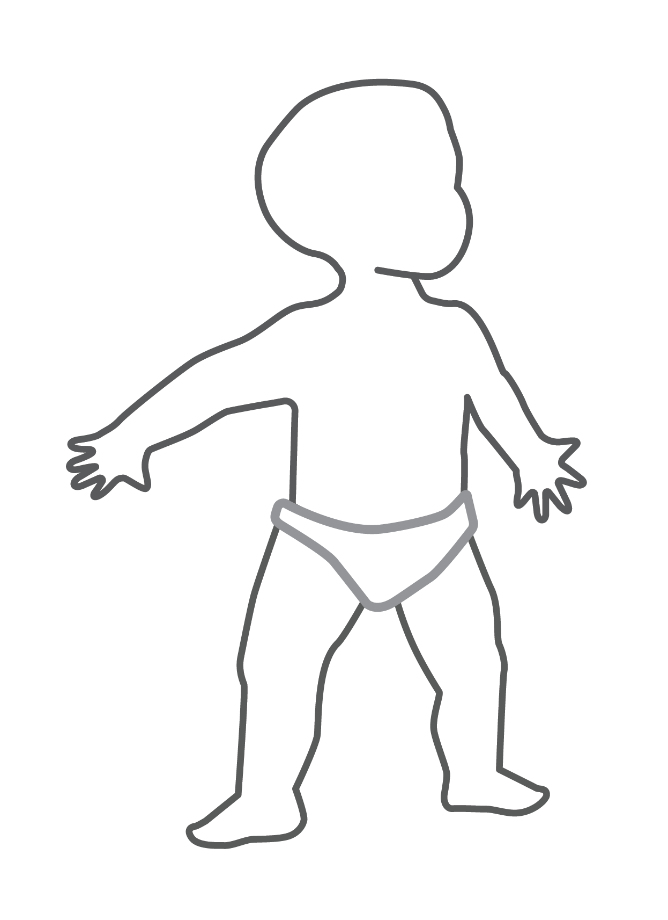



Note to Countries:
A Comparison of Safety, Tolerability and Immunogenicity of Oka/Merck Varicella Vaccine and VARILRIXTM in Healthy Children
Reference citation boxes are included in this summary card, but are hidden.
To ‘show’ them go to:
Home>Select>Selection Pane>REFs
Click on the dash beside REFs and it will turn to an ‘eye’ icon, making the R EFs visible on screen. To hide again, click on the ‘eye’ icon.
Lau Y-L, Vessey SJ, Chan ISF, et al. Vaccine. 2002;(20): 2942-2949.
Study title/annotation: Lau: p2942A
This contains selected information from this study. The full publication should be consulted for complete information.
Study Description
In this study, the gpELISA (an assay that detects antibodies to varicella zoster virus [VRV] that have been partially purified) was used to compare the safety, tolerability, and immunogenicity of the Oka/Merck varicella vaccine and VARILRIX™ in healthy children between 12 months and 24 months of age.
Lau et al was a randomized: Lau et al: p2943C]
Study description section: Lau et al: p2943A,2943B]
Study Design
This study was a
randomized, double-blinded, multicenter clinical study.
Patient demographics
were similar across
treatment groups
Patients followed for 42
days postvaccination
to monitor for adverse
reactions
614 healthy children
randomized 1:1:1 to receive
one vaccination dose with:
Patients randomized 1:1:1 and treatment groups : Lau et al: p2943C,2943D]
Immunization Site Map
Suggested sites for toddler immunizations
Oka/Merck varicella vaccine (~50,000 PFU/dose)
and M-M-RTM II
N = 206
Varicella
M-M-R™ II
Group A
Patient demographics: Lau et al: p2944A]
Oka/Merck varicella vaccine (~16,000 PFU/dose)
and M-M-RTM II
N = 205
Group B
Group C
VARILRIXTM (~40,000 PFU/dose)
and M-M-RTM II
N = 203
Varicella
M-M-R™ II
Patients followed for: Lau et al: p2943F]
Location of injection sites: Lau p2943E]
Primary efficacy endpoint:
Between-group differences in the percent of patients with varicella antibody titers ≥5 gpELISA units
6 weeks postvaccination
Healthy children between 12 and 24: Lau p2943G]
Healthy children
between 12 months and 24 months of age with no clinical history of measles, mumps, rubella, varicella, or zoster were eligible for enrollment
Key exclusion criteria included:
Prior vaccination with varicella-containing vaccines
Recent vaccination (within 14 days for inactivated vaccine and 30 days for live vaccine), or planned vaccination with 42 days of study enrollment
Clinically significant exposure to measles, mumps, rubella, varicella, or zoster in the 4 weeks prior to study enrollment
Secondary efficacy endpoint:
Seroconversion rates to measles, mumps, and rubella for patients
who were seronegative to these antigens prior to vaccination
Primary efficacy endpoint: Lau et al: p2944B]
Key Exclusion criteria: Lau p2943G]
Abbreviations: M-M-R™ II, measles, mumps, and rubella virus vaccine, live, MSD; PFU, plaque-forming units
VARILRIXTM is a registered trademark of the GlaxoSmithKline Group of Companies.
Secondary efficacy endpoint: Lau et al: p2944C]
For Training Purposes Only Not for Promotional Use HQ-VVX-00034 08/2019.

Slide 2



A Comparison of Safety, Tolerability and Immunogenicity of Oka/Merck Varicella Vaccine and VARILRIXTM in Healthy Children
Lau Y-L, Vessey SJ, Chan ISF, et al. Vaccine. 2002;(20): 2942-2949.
Study Results
Proportion of Patients With a Prevaccination Varicella Antibody
Titer of <1.25 gpELISA Units With Varicella Antibody Responses
6-Weeks Postvaccination
Primary
Endpoint
Varicella antibodies responses table/note: Lau et al: p2945A]
Characteristic | Group A N = 189 | Group B N = 191 | Group C N = 194
Postvaccination titer ≥5 gpELISA units, % (95% CI) | 96.8 (93.2–98.8) | 95.3 (91.2–97.8) | 85.6 (79.8–90.2)
Between-group difference, % (95% CI) | 11.5 (6.3–17.5) | 9.6 (3.9–15.8) | —
GMT | 14.2 (12.6–15.9) | 16.7 (14.9–18.6) | 9.4 (8.4–10.4)
GMT ratio (95% CI) | 1.5 (1.3–1.8) | 1.8 (1.5 –2.1) | —
The study by Lau et al was designed: Lau et al: p2944E]
The study by Lau et al was designed to establish the noninferiority of Oka/Merck compared with VARILRIX™. Group A (or B) immune response rate was shown as clearly noninferior to that of Group C. The lower bound of the 95% CI for the weighted difference was entirely above zero; thus, results show superior immune response rates to both dose levels of the Oka/Merck varicella vaccine compared with VARILRIX^{TM.}.
Group A (or B): Lau et al: p2945A]
Adapted from: “A Comparison of Safety, Tolerability and Immunogenicity of Oka/Merck Varicella Vaccine and VARILRIXTM in Healthy Children.”
STOP
Note: Percentage ≥5 gpELISA units and GMT and their difference/ratio were calculated using a statistical analysis model that adjusted for study centers.
Secondary
Endpoint
Measles
99.1%
to 100 %
Mumps
99.4 %
to 100 %
Rubella
99.5 %
to 100 %
Seroconversion rates for measles,
mumps and rubella: p2948A]
Seroconversion rates for measles, mumps, and rubella 6 weeks postvaccination among patients who were seronegative prevaccination
In all 3 treatment groups, the immune responses
observed for measles, mumps, and rubella were consistent
with those reported in previous studies.
In all 3 treatment groups: Lau et al: p2945B]
Safety Results
No vaccine-related serious: Lau et al: p2944D]
No vaccine-related serious adverse
experiences were reported in any patient
Study Conclusions: Lau et al: p2948B
Vaccine-related systemic events* | Group A N = 204 | Group B N = 203 | Group C N = 200
Any | 23.6% | 24.5% | 19.0%
Fever‡ | 25.5% | 19.5% | 19.1%
Varicella vaccine Injection site reactions† | 17.6% | 21.7% | 19.5%
Study Conclusions
This study established the noninferiority of Oka/Merck to VARILRIX™. In this study, vaccination with Oka/Merck resulted in significantly higher varicella antibody titers compared with VARILRIXTM. The tolerability of the two vaccines was similar.
Vaccine-related systemic: Lau et al: p2944D]
Fever: Lau et al: p2945D]
Varicella vaccine injection site: Lau et al: p2945C]
Differences were not: Lau et al: p2944D,2945C,2945D]
* Differences were not statistically significant.
† Most common: pain/tenderness/soreness; erythema.
‡ Fever ±102°F or “abnormal temperature” were reported.
Most common: Lau et al: p2945C]
Abbreviations: CI: confidence interval; gpELISA: glycoprotein enzyme-linked immunosorbent assay; GMT: geometric mean titer; SCR: seroconversion rate.
VARILRIXTM is a registered trademark of the GlaxoSmithKline Group of Companies.
For Training Purposes Only Not for Promotional Use HQ-VVX-00034 08/2019.

